Slide 1
Version control

Slide 2
Version Control Systems
Version control systems are software tools that help software teams manage changes to source code over time.
Version control software keeps track of every modification to the code in a special kind of database. If a mistake is made, developers can turn back the clock and compare earlier versions of the code to help fix the mistake while minimizing disruption to all team members.

Slide 3
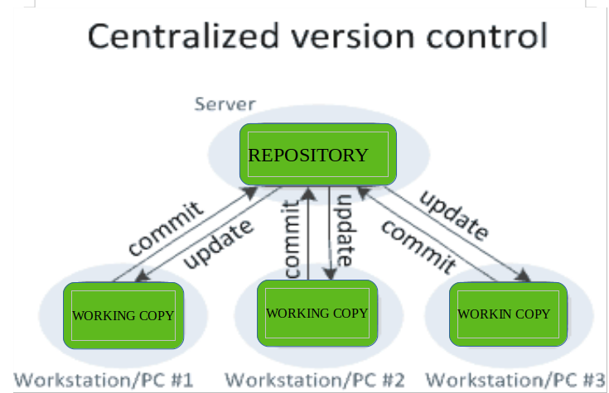
Centralized VCS
Subversion (SVN), Concurrent Version System (CVS)

Slide 4
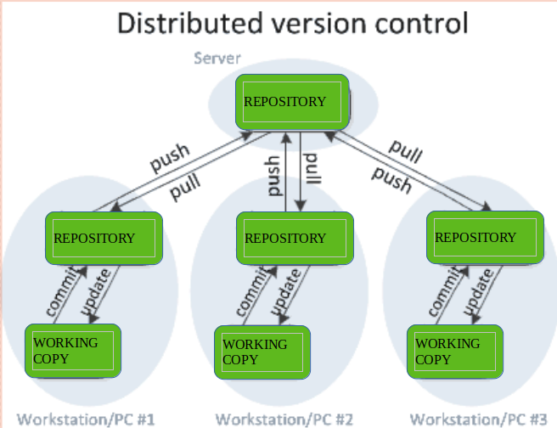
Distributed VCS
Git, Mercurial

Slide 5
git
Notes:
Git != github
Git is a version control system that lets you manage and keep track of your source code history. GitHub is a cloud-based hosting service that lets you manage Git repositories

Slide 6
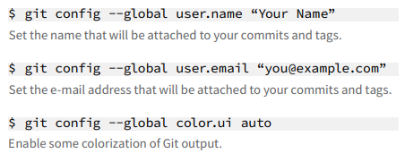
Git configuration - cumbersome setup work

Slide 7
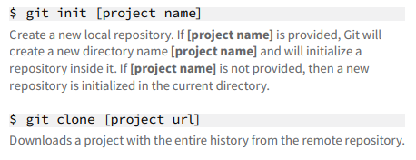
Starting a Project - exciting times ☺

Slide 8
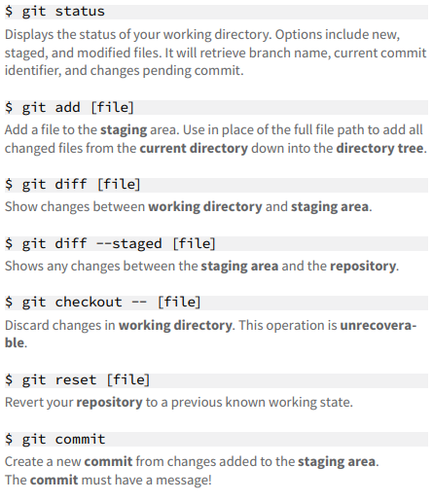
Day-To-Day Work - wtf I did today?

Slide 9
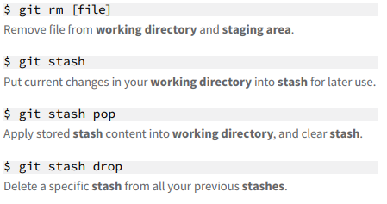
Day-To-Day Work – ok, let’s keep it somewhere safe

Slide 10
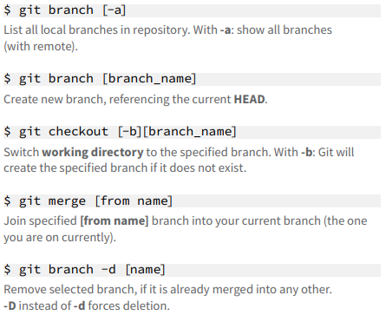
Git branching model - time to work

Slide 11
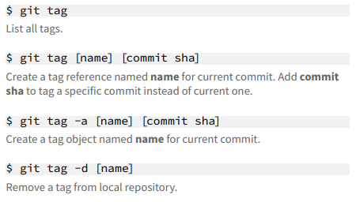
Tags final-copy-2-stable

Slide 12
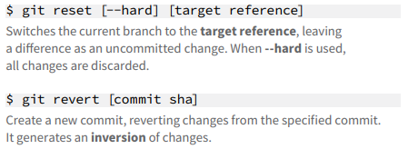
Reverting changes - Dijo mi mamá que siempre no.

Slide 13
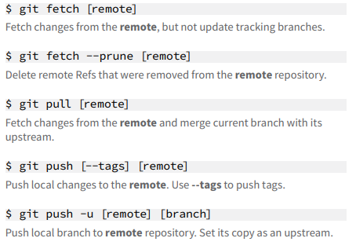
Synchronizing repositories - finally it’s finished

Slide 14
Merge conflicts - oh no
A merge conflict is an event that occurs when Git is unable to automatically resolve differences in code between two commits
When there are conflicting changes on the same lines, a “merge conflict” occurs because Git doesn't know which code to keep and which to discard.

Slide 15
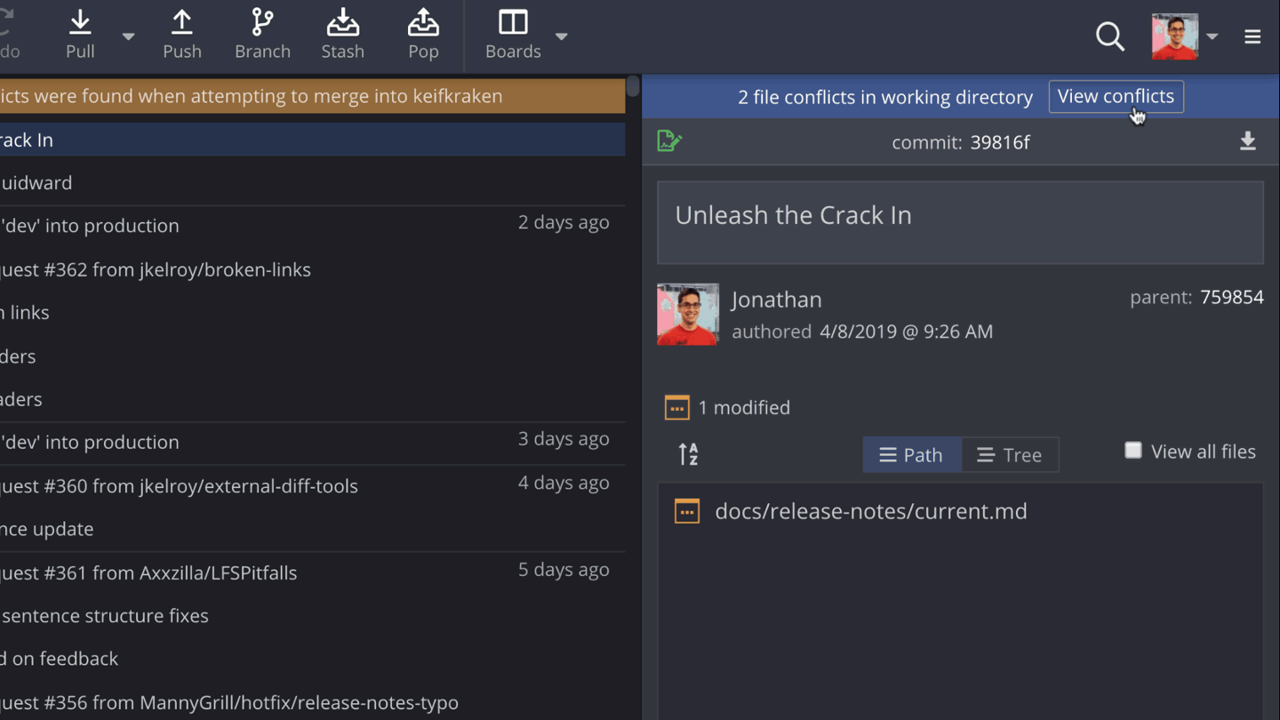

Slide 16

GitFlow

Slide 17
References
https://about.gitlab.com/images/press/git-cheat-sheet.pdf
https://www.geeksforgeeks.org/version-control-systems/
https://nvie.com/posts/a-successful-git-branching-model/
Official git documentation
https://git-scm.com/doc
GitHub flow
https://guides.github.com/introduction/flow/
GitFlow vs GitHub flow vs Trunk-based development
https://launchdarkly.com/blog/git-branching-strategies-vs-trunk-based-development/
Git GUIs
https://git-scm.com/downloads/guis

